Slide 1
AS Degree in IT (Fall 2015) Ohlone College Case Study
Richard grotegut, Ohlone College

Slide 2
30 years of waiting
32
TECH PREP
Pathways
2+2+2
Articulation
AB-405 CC BS in IT-Cybersecurity
Where are the CSUs??????
Notes:
Here’s why the ICT sector is important.

Slide 3
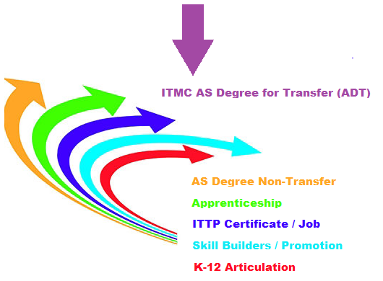
Another OpTION

Slide 5
The PCAH (pa caw)
400+ pages of do’s and don’t’s

Slide 6
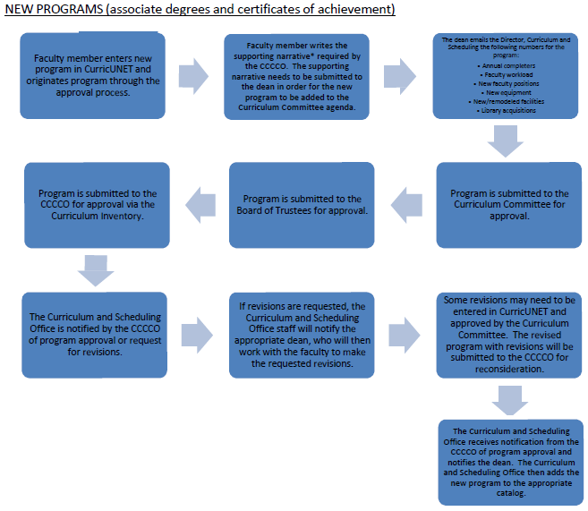

Slide 7
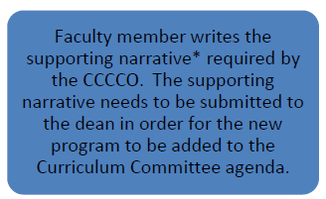

Slide 8
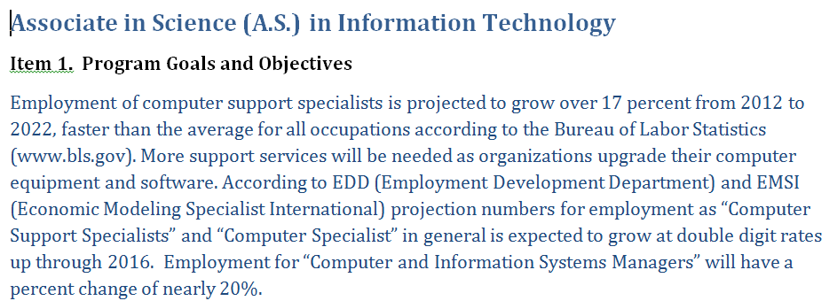

Slide 9
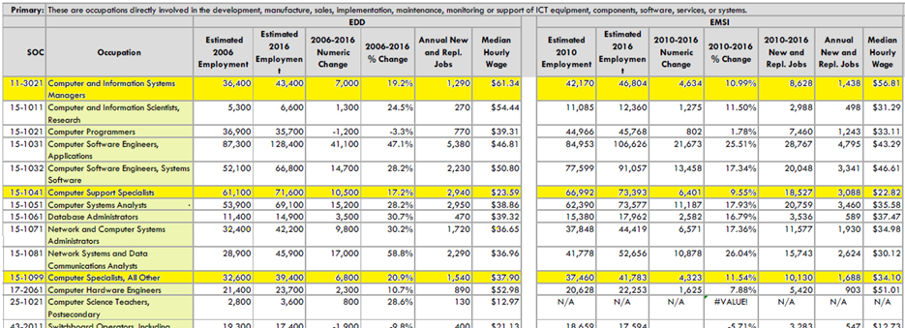

Slide 10
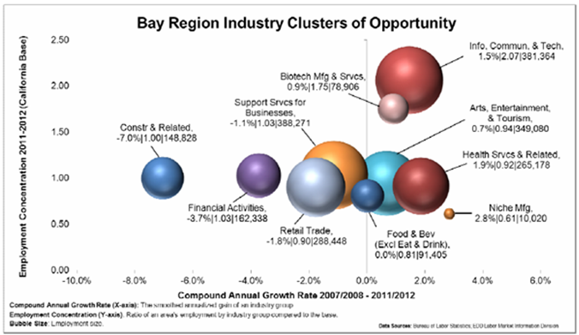

Slide 11
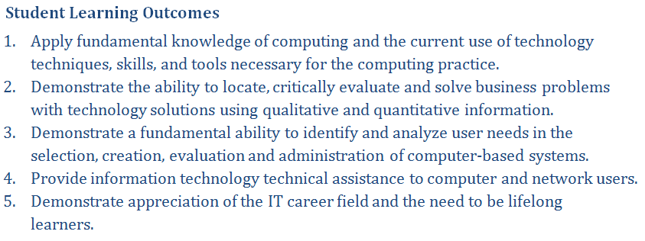

Slide 12
Notes:
12

Slide 13
Notes:
CSU resistance to an IT/ICT model curriculum does not mean there is no need for a common foundation for IT/ICT education in California public education systems. We need that within the CCC system and to build pathways from K-12 to CCCs also.

Slide 14
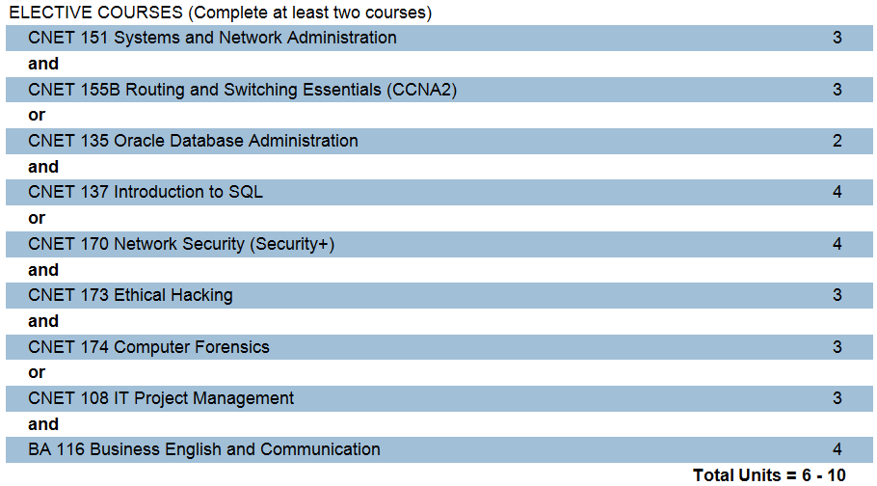
Notes:
CSU resistance to an IT/ICT model curriculum does not mean there is no need for a common foundation for IT/ICT education in California public education systems. We need that within the CCC system and to build pathways from K-12 to CCCs also.

Slide 15
Database classes don’t match total of 6 units instead of 3
Project Management does not equate to the Systems Analysis course
Notes:
CSU resistance to an IT/ICT model curriculum does not mean there is no need for a common foundation for IT/ICT education in California public education systems. We need that within the CCC system and to build pathways from K-12 to CCCs also.

Slide 16
Notes:
CSU resistance to an IT/ICT model curriculum does not mean there is no need for a common foundation for IT/ICT education in California public education systems. We need that within the CCC system and to build pathways from K-12 to CCCs also.

Slide 19
Additional Requirements
Program Requirements Table
Regional Consortium Approval
Advisory Meeting (w/ approval recorded in minutes)
TOP Codes
Submission of course outlines for review against C-ID course descriptors

Slide 20
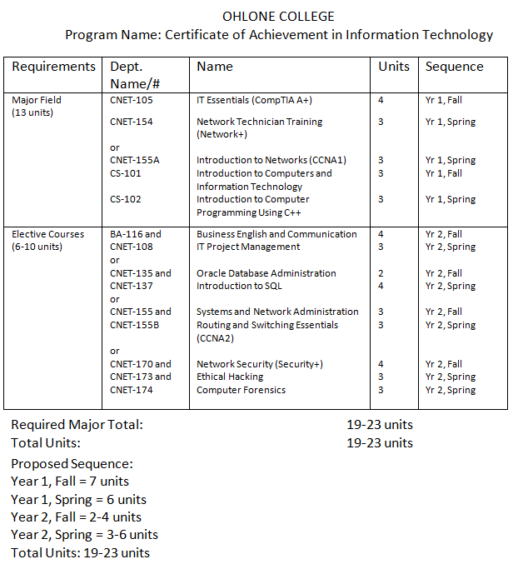
Program Requirements Table

Slide 21
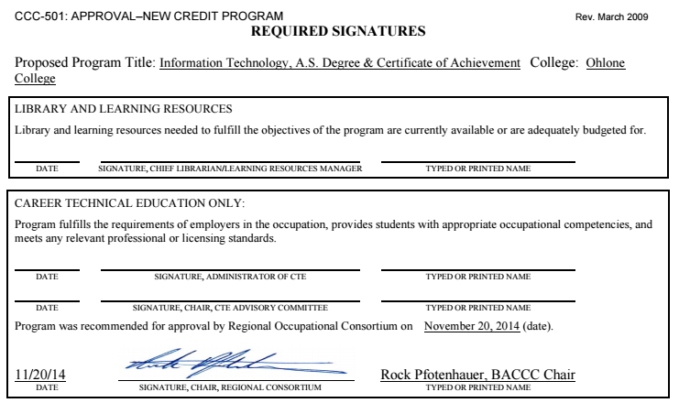

Slide 22
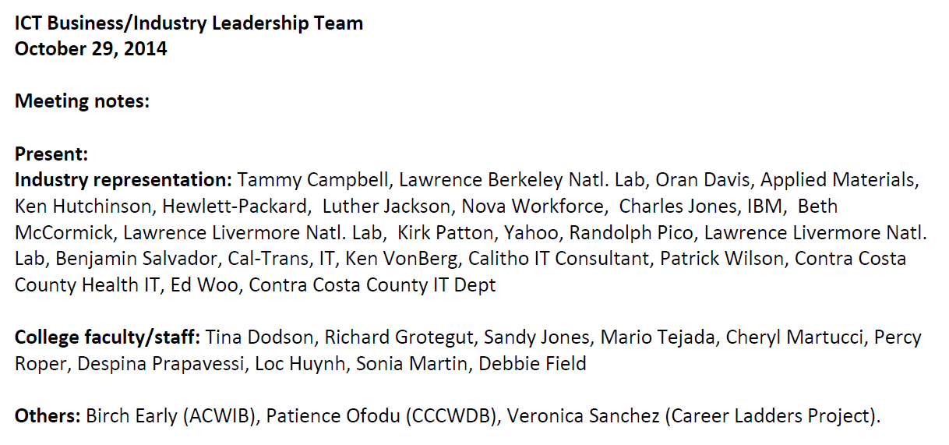

Slide 24
Taxonomy of Programs (TOP) codes
Identify the discipline area for a course or program.
Why are the codes important?
Courses and programs are tracked across the state for data and evidence of student success and other important outcomes.
Correct coding will provide reliable data on student progress and achievement.
Some funding mechanisms in the state are also tied to how courses are coded.
Curriculum committee members should be knowledgeable about the different codes

Slide 25
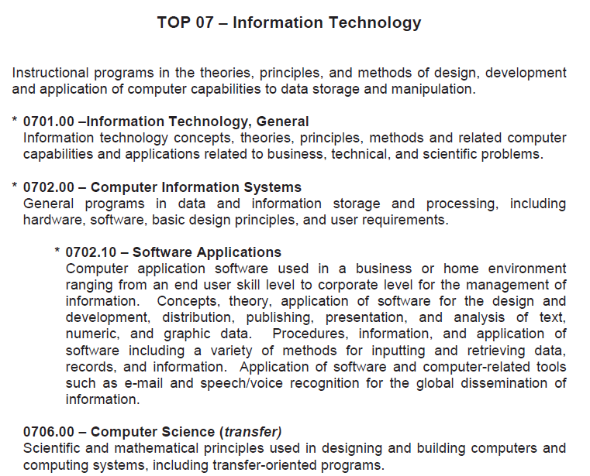

Slide 27
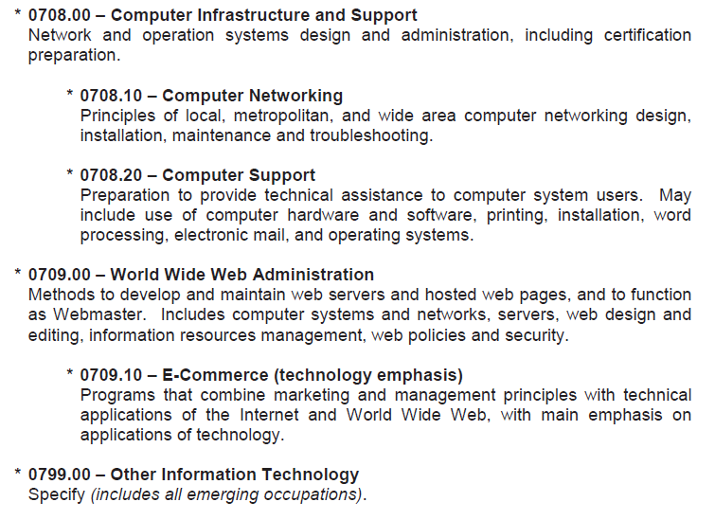

Slide 28
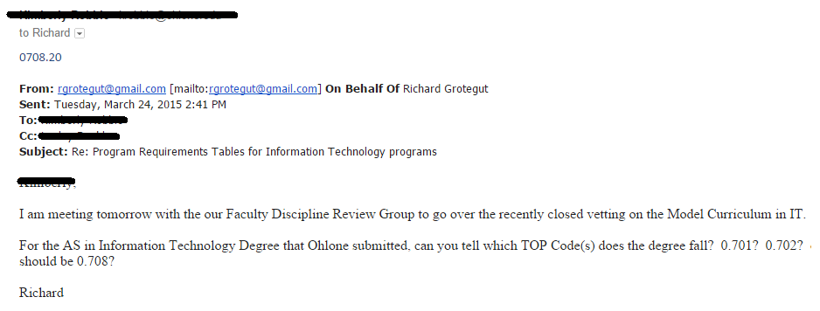
Identifying the Right TOP Code

Slide 29
Identifying the Right TOP Code

Slide 30
Identifying the Right TOP Code

Slide 31
Identifying the Right TOP Code

Slide 32
Taxonomy of Programs (TOP) codes
Identify the discipline area for a course or program.
Why are the codes important?
Courses and programs are tracked across the state for data and evidence of student success and other important outcomes.
Correct coding will provide reliable data on student progress and achievement.
Some funding mechanisms in the state are also tied to how courses are coded.
Curriculum committee members should be knowledgeable about the different codes

Slide 34
Resources
CCC Curriculum Inventory
Regional Consortium and Center of Excellence
LaunchBoard

Slide 35
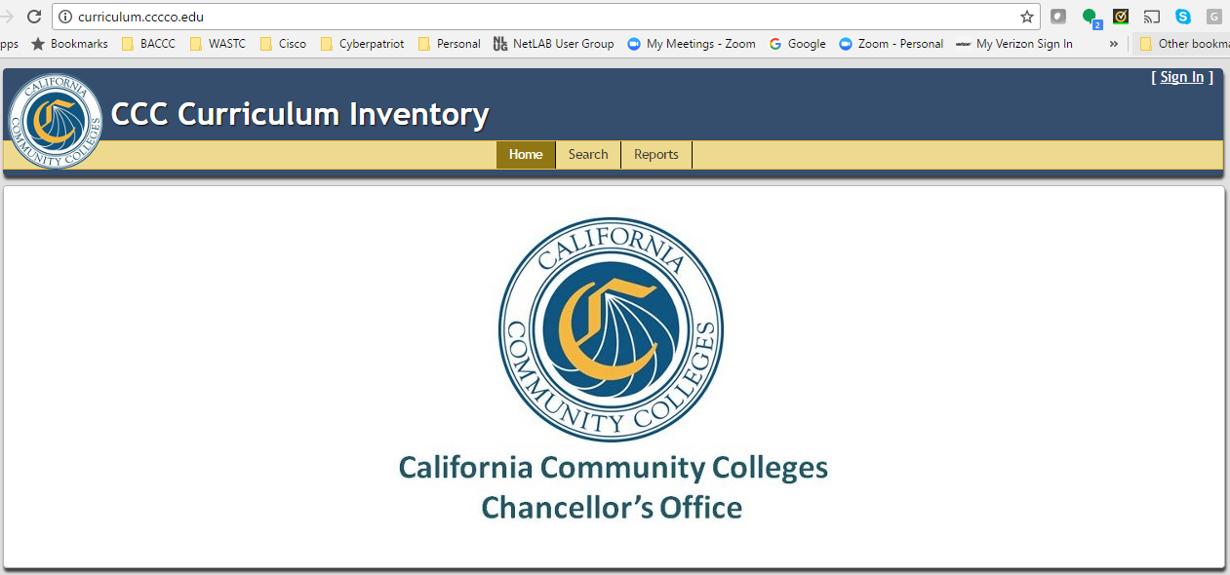
CCC Curriculum Inventory - http://curriculum.cccco.edu/

Slide 36
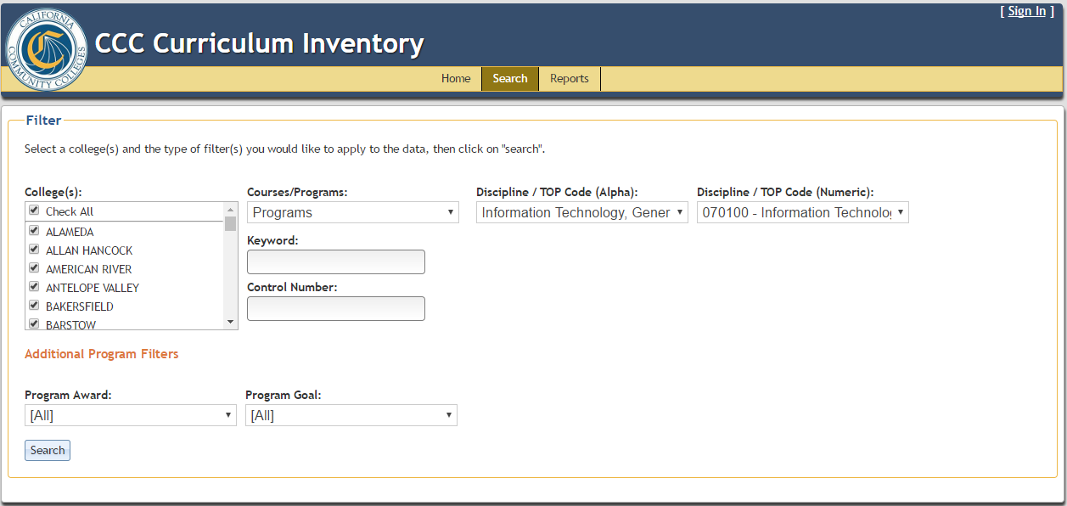

Slide 38
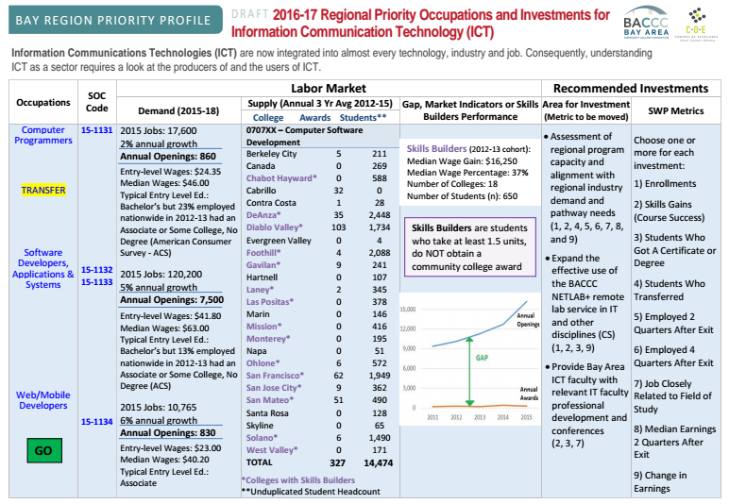
Labor Market Data

Slide 39
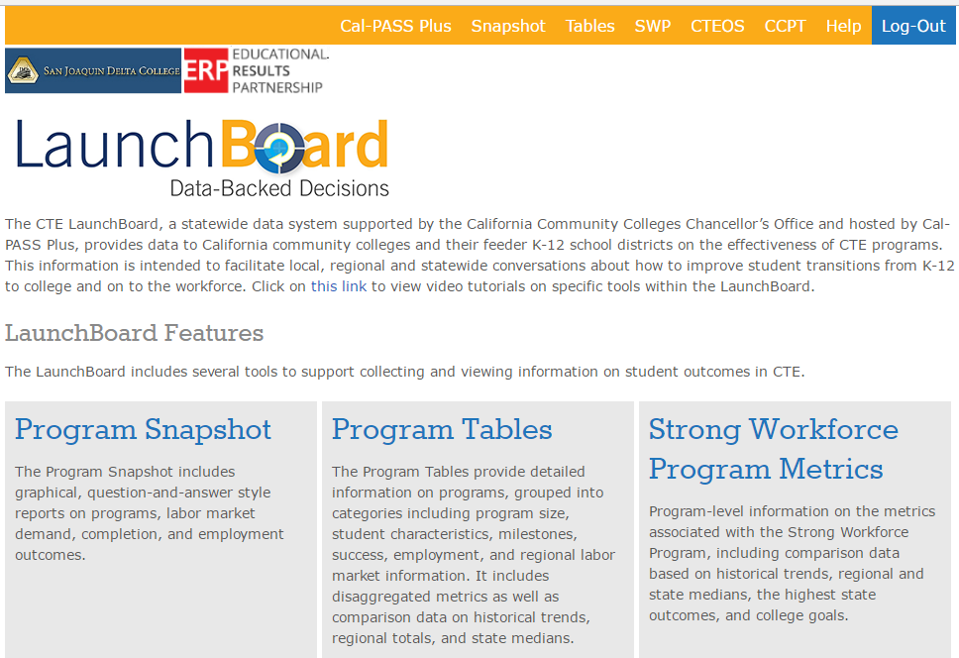
Launch Board

Slide 40
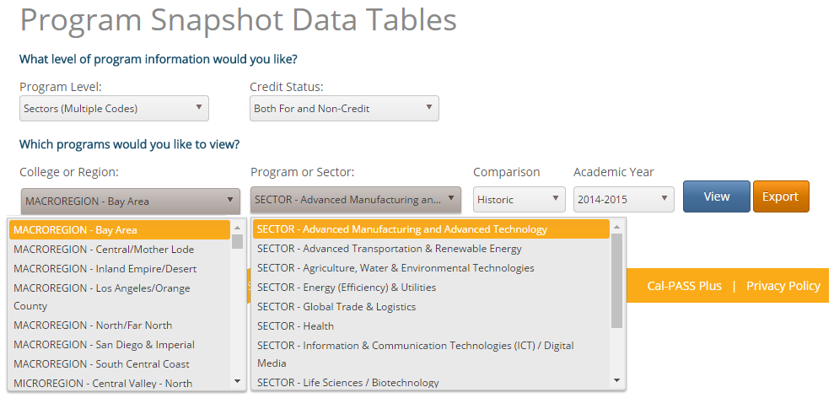

Slide 41
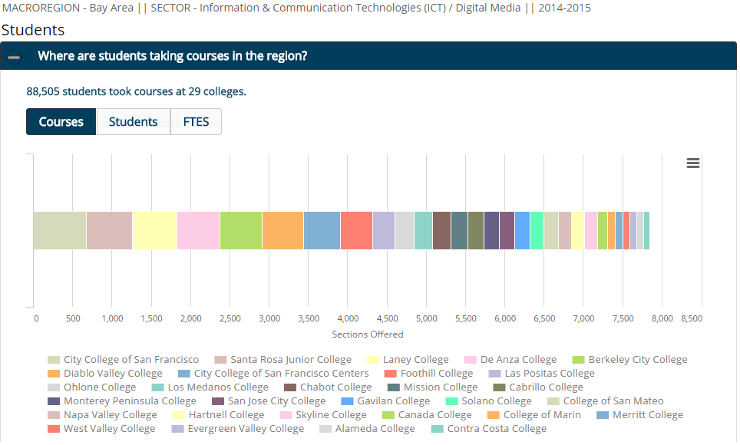

Slide 42
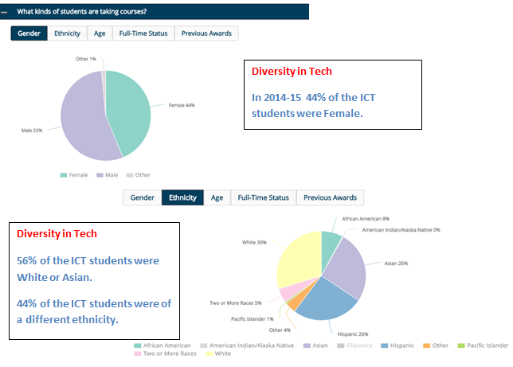

Slide 43
Review
Crosswalk your courses with the C-ID course descriptors
Reference the PCAH
Complete the Supporting Narrative
Program Requirements Table
Regional Consortium Approval
Advisory Meeting (w/ approval recorded in minutes)
TOP Codes
Submission of course outlines for review against C-ID course descriptors

