Slide 1
Aviation and Technology Department
San Jose State University
Computer Network System Management
Presented at
Partner Summit Networking Academy 2017
Cisco HQ, San Jose, California
July 27, 2017
Presented By
Dr. Fred Barez, Chair

Slide 2
aviation and technology department
2 Programs:
  Aviation (240 students)
  Technology (280 students)
Technology:
  Manufacturing System Concentration
  Computer Network System Management Concentration (Fall 2018)
  (Students may enroll in new courses Fall 2017)

Slide 3
Computer Network System Management
Partnership with Cisco Systems to develop workforce for the ‘Connected’ world.
Cisco Apprenticeship Academy Program offered by Cisco Systems.

Slide 4
Cisco Apprenticeship Academy
WHAT - Cisco Apprenticeship Academy is a development program aimed at onboarding the diverse talent we want with the skills we need to help Cisco thrive in the digital economy.
HOW - Leverage existing educational programs, processes and resources to pilot an apprenticeship model in FY17
WHO - Pilot 100 students, Partner with Two Universities: San Jose State and North Carolina State

Slide 5
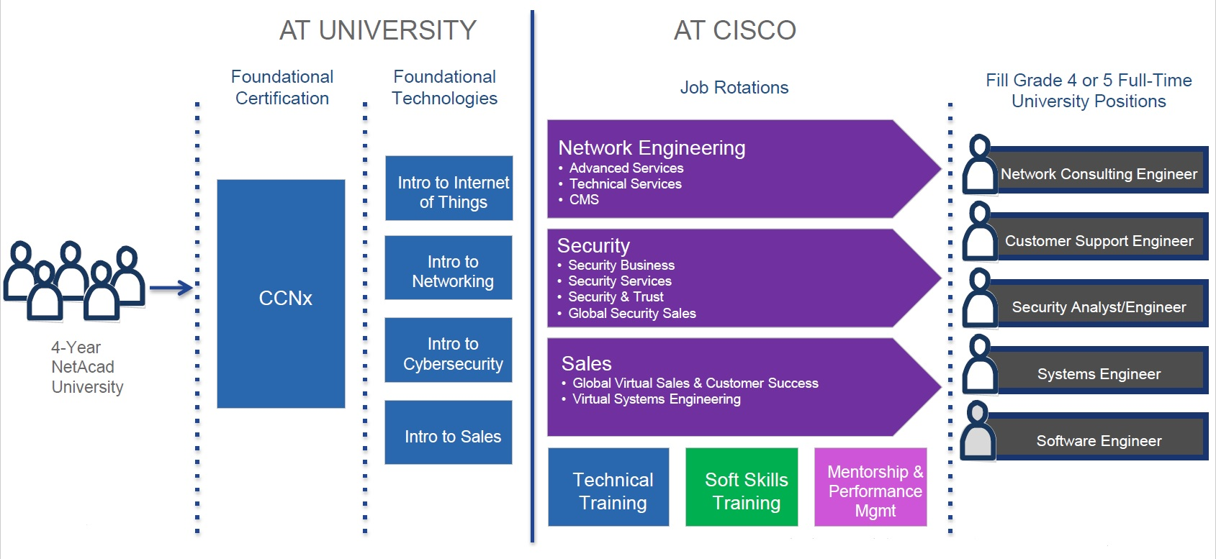
existing Cisco Apprenticeship
Program model

Slide 6
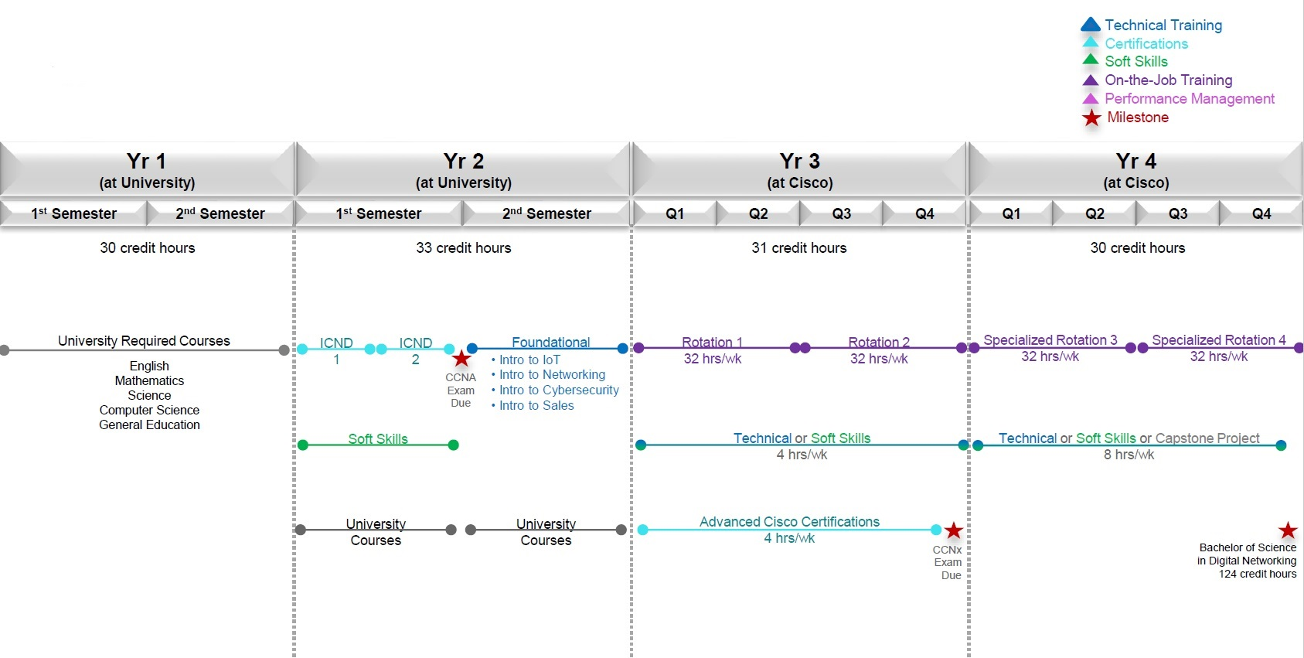
4-year university track Program

Slide 7
BS Industrial Technology (IT) Degree with Concentration in
Computer Network System Management
First Year
Fall Semester Spring Semester
Engl 1A Composition I 3 Engl 2 Composition II 3
General Education A1 3 Math 71 Calc for Bus & Aviation 3
Engr 10 Introduction to Engineering 3 CmpE 30 Program Concept and Method 3
Tech 60 Intro to Electronics 3 Tech 63 Analog & Digital Circuits 3
Tech 65 Network Theory & Apps (CCNA 1) 3 Tech 67 Intro to Internet of Things 3
Total 15 Total 15
Second Year
Fall Semester Spring Semester
Phys 2A Fundamentals of Physics 4 Phys 2B Fundamentals of Physics 4
Tech 66 Network Administration (CCNA 2) 3 Tech 68 Internet of Things Sysytems (CCNA 3,4) 3
Econ 1B Principles of Economics: Micr 4 General Education C2 3
General Education C1 3 Genearl Education D1 3
General Education D2 3
Total 14 Total 15

Slide 8
Third Year
Fall Semester Spring Semester
Chem 1A General Chemistry 5 Engr 100W Technical Reports 3
General Education D3 3 Bus 140 Fund of Operations Mgnt 3
Bus 90 Business Statisctics 3 Bus 146 Project Management 3
Tech 165 Wireless Communication 3 Tech 171 Network Sec & Prevent Mgmt 3
Tech 170 Connected Products Applications 3 Tech 145 Lean Manufacturing 3
Total 17 Total 15
Fourth Year
Fall Semester Spring Semester
Tech 190A Senior Project I 3 Tech 190B Senior Project II 3
Bus 142 Total Quality Management 3 Tech 198 Tech & Civilization (GE: V) 3
Tech 179 Cyber Security Systems Mgmt 3 Tech 136 Software Quality Mgt 3
Tech 173 Cloud Comp System Mgmt 3 Technical Elective 3
Bus 186 Prof & Bus Ethics (GE: S) 3 Technical Elective/Coop/Internship 1
Total 15 Total 13
Total: 120 Semester Units
Technical Elective: Database System Management

Slide 9
Critical Success Criteria
SCHOOL
SJSU’s willingness and ability to create a new degree program in support of apprenticeship program
SJSU students willing to be off campus for 2 years during apprenticeship
SUSU faculty’s willing ness to adapt curriculum in support of the apprenticeship program
CISCO
Financial commitment from Cisco Systems to pay for salaries during apprenticeships
Commitment from Cisco Systems during apprenticeship and after for full-time employment
Partner with schools near hiring locations

Slide 10
SJSU
Intro to Internet of Things
IoT Systems
Network Administration
Network Theory and Applications
Wireless Communication
Design of Connected Products
Network Security and Prevention
Cyber Security Sys Management
Senior Projects
Database System Management
Cisco Certificates
CCENT
CCNA
CCNA-S
CCNP
Emerging IoT and Cybersecurity-related Certifications
Cisco NetAcad and SkillZone
CCNA 1 (Intro to Networks)
CCNA 2 (Routing and Switching Essentials
CCNA 3 (Scaling Networks)
CCNA 4 (Connecting Networks)
CCNA-S (security)
Connecting Things
Big Data and Analytics
Rapid Prototyping
Hackathon
IoT Systems

Slide 11
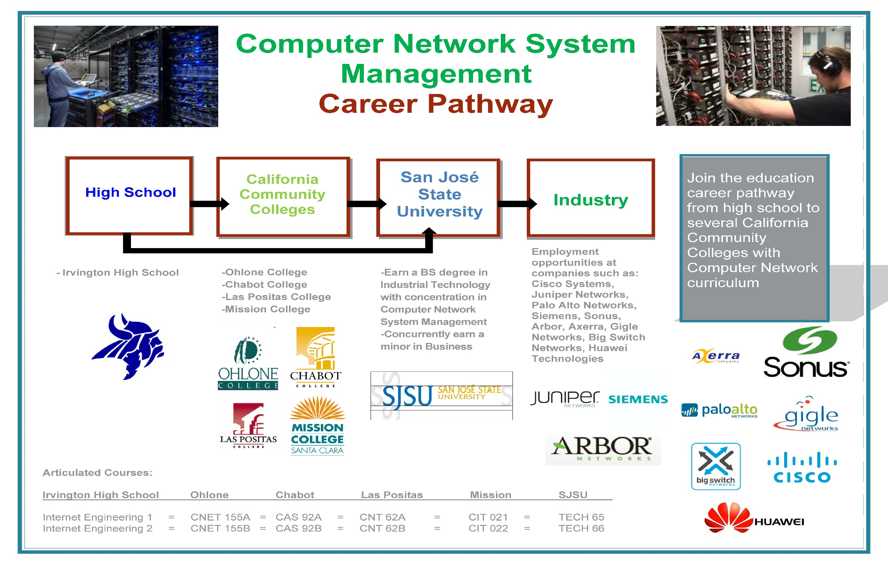

Slide 12
Thank You

